Slide 1
Bracketeering (BMAC Tech Tips)
By Lenny Spall

Slide 2
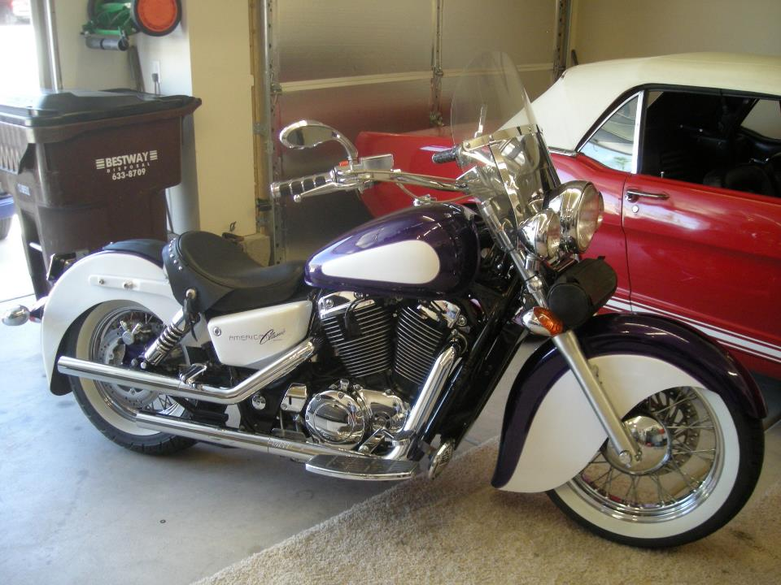
Nice looking bike..!

Slide 3
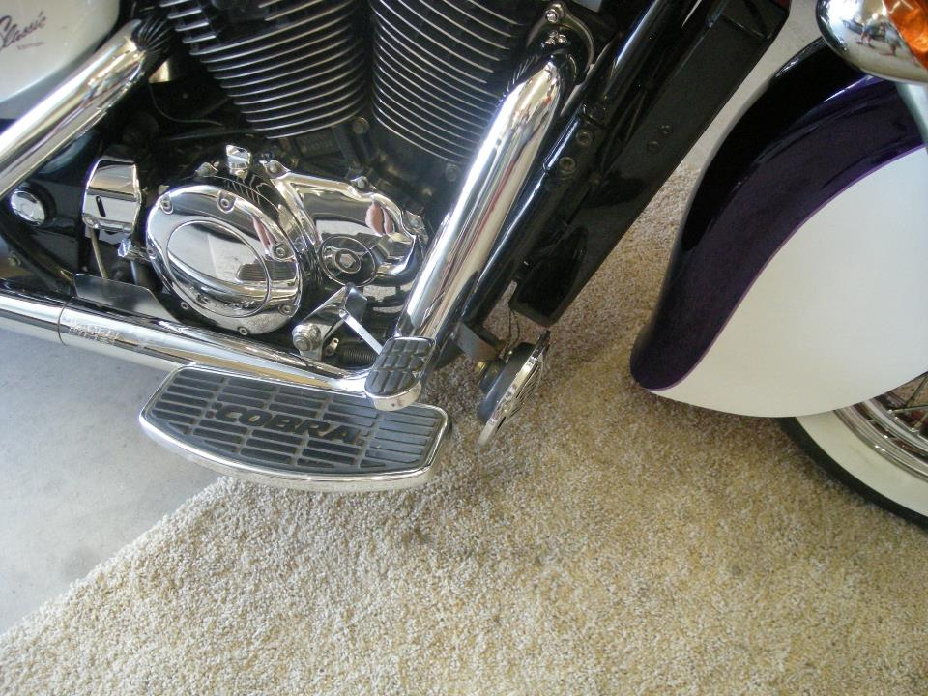
Zooming in…

Slide 4
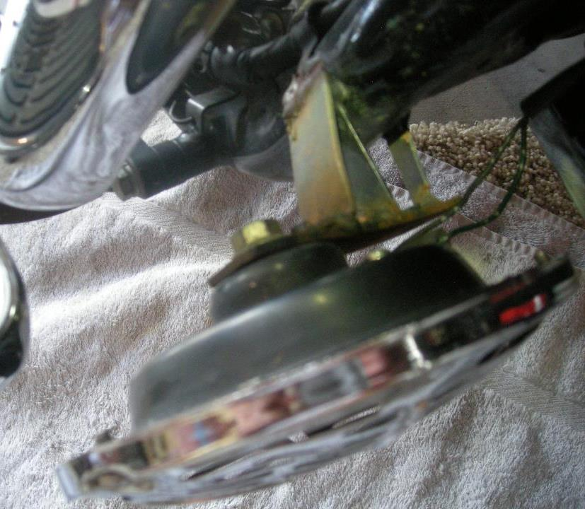
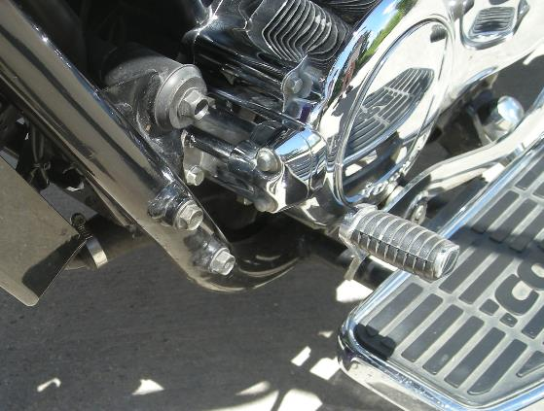
Ugly bracket!
Look at this!

Slide 5
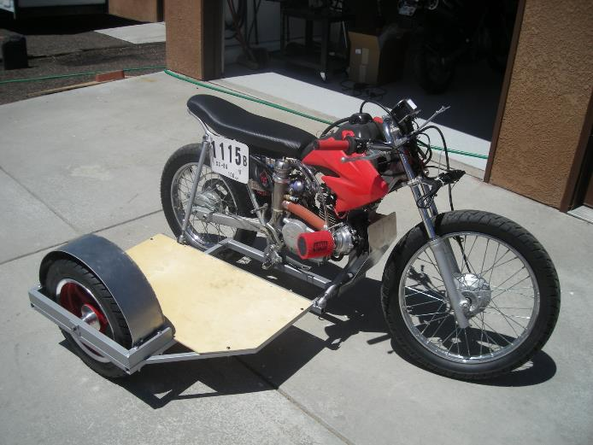
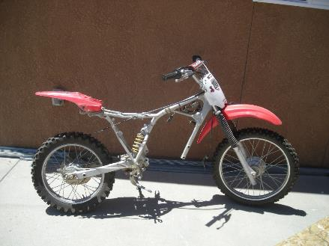
Purpose: to support or attach components,
instrumentation & splash protection.
Before
After

Slide 6
5052-H32 Aluminum Specifications
Properties are good workability (useful in forming operations)
Good corrosion resistance, especially to salt water and fuel & oil lines
High fatigue strength and withstands excessive vibrations
Has the best welding characteristics of all the aluminums
Widely used for storage tanks, truck/trailer components, electronic chassis, etc. and parts requiring strength and good formability at reasonable cost.
Frank uses 0.063” (~$3.50 per sq ft) and
0.09” (~$6.30 per sq ft) Aluminum sheets

Slide 7
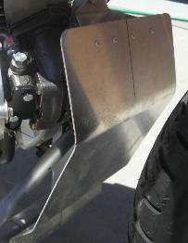
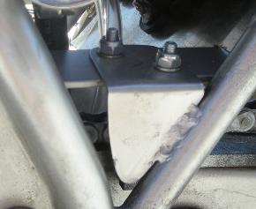
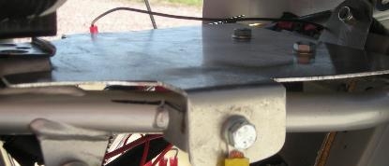
Bracket Fabrication & Fasteners
Rivet
Weld
Bolt

Slide 8
Fabrication Steps
Determine thickness of bracket
Determine how to attach
Make cardboard template
Fabricate with metal

Slide 9
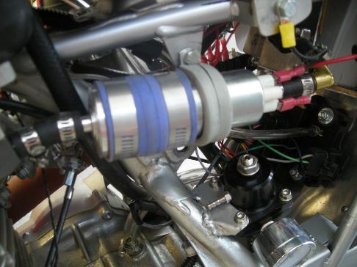
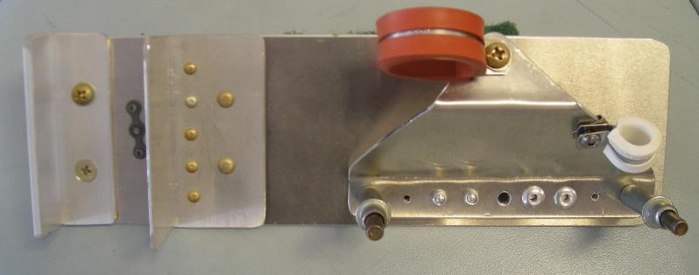
Fabrication Examples

Slide 10
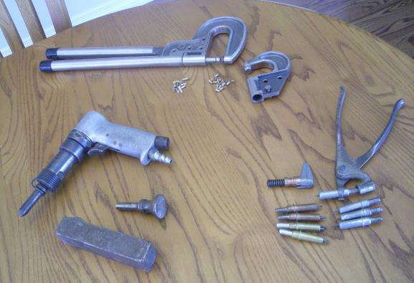
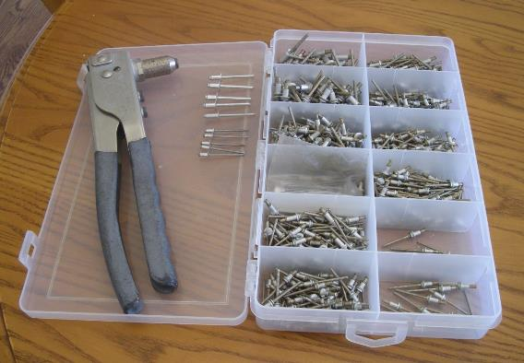
Aluminum Working Tools

Slide 11
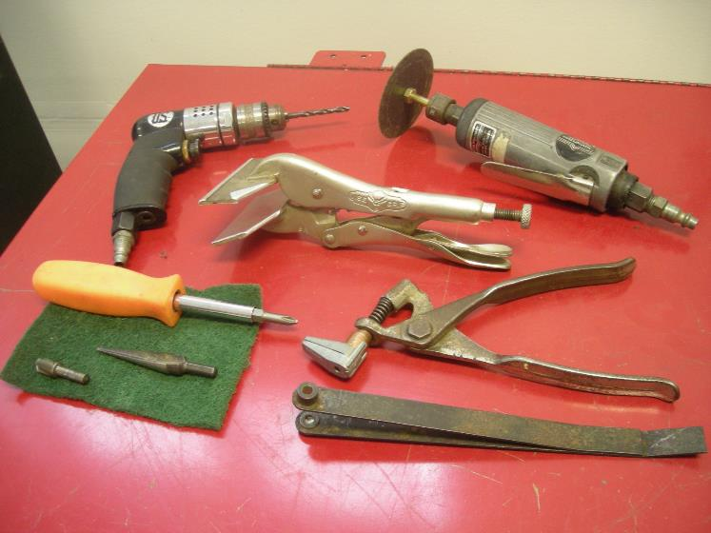
More Tools

Slide 12
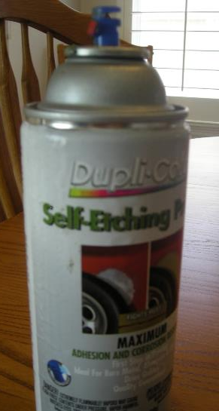
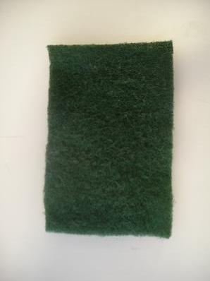
Finishing Aluminum
Nothing
Scotchbright
Polish
Paint
Powdercoat

Slide 13
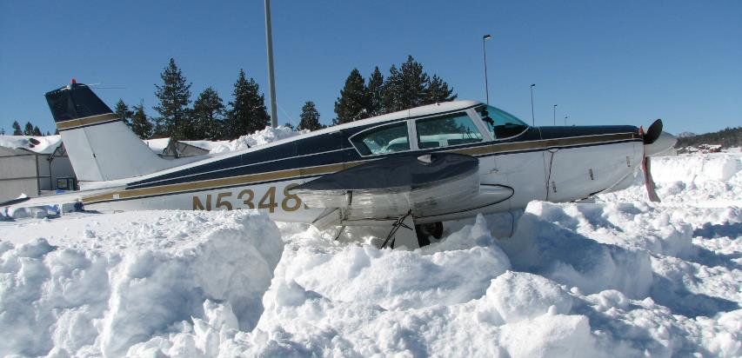
My Plane

Slide 14
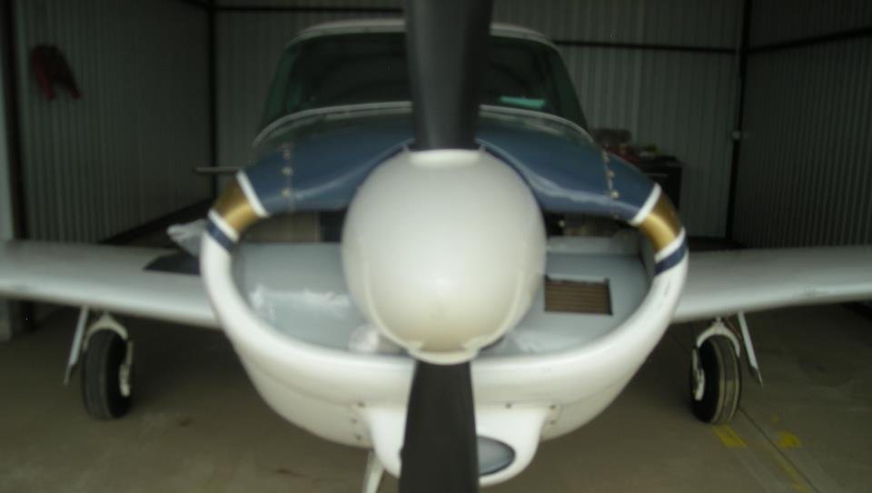
Inlet Air Deflector Panels

Slide 15
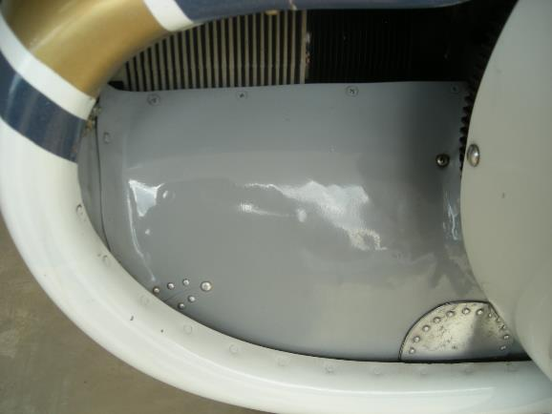
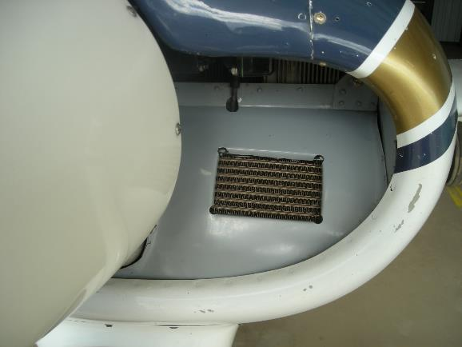
Close up
After Market certified panels = $450 each
Fabrication costs: Materials $30 & Powder coating $30

Slide 16
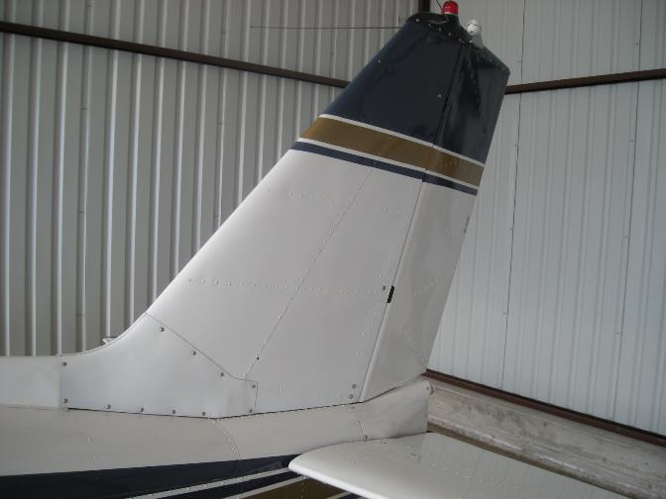
Vertical Stabilizer Leading Edge Panel
After Market certified panel = $280
Fabrication costs: Material on hand; tools $12

