Slide 1
Motorcycle gas tank rust removal & sealing
Notes:
These are suggested instructions
Only applicable to steel gas tanks
Sealer won’t work on plastic or fiberglass tanks

Slide 2
My Honda CB750F needed the gas tank sealed

Slide 3
The rustiest tank ever !

Slide 4
Found a better used tank, still needed rust removed & sealed

Slide 5
What you need to do it right ! “Prep & Etch” from Home depot
- Read all the directions on the Prep Etch container

Slide 6
Then the sealer . . . Available on Ebay

Slide 7
Basic steps Note: ( recommended you start in the morning, that way you can keep an eye on the tank during the 8 hour process)
Remove gas cap and petcock
If present remove any loose rust in the tank (drop large hex nuts in the tank, shake vigorously)
Tank inside must be free of any grease, oil, etc. (use gasoline, MEK, etc. to rinse out tank)
Set tank aside to completely dry out ( set it outside in the sun)

Slide 8
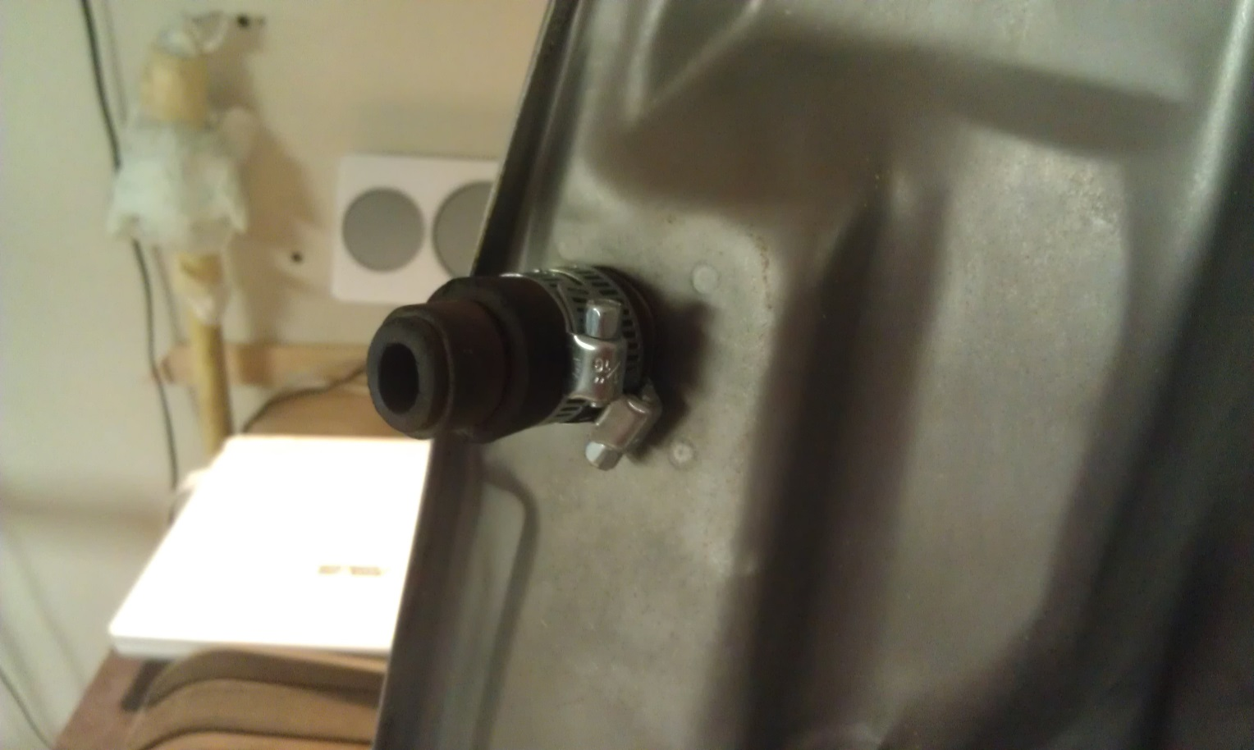
Petcock plug
Fashion a petcock plug for the bottom

Slide 9
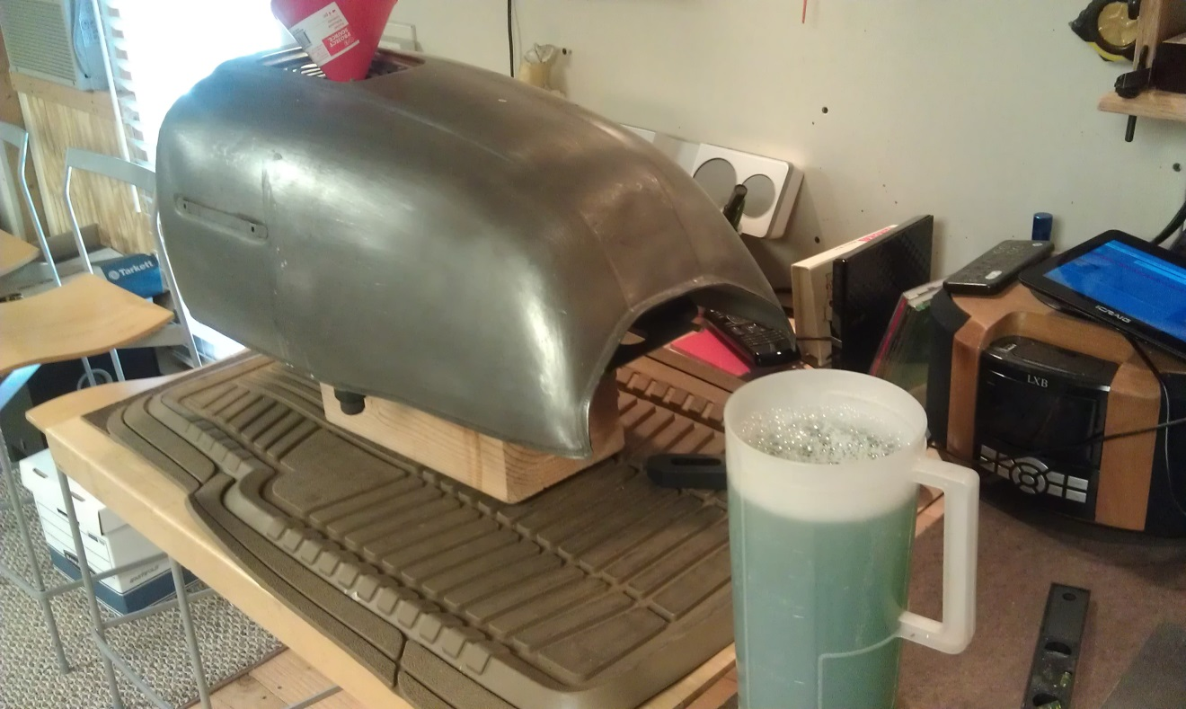
Prepare the Phosphoric etch
In a large plastic container mix 4 parts water to 1 part phosphoric etch solution. (1 gallon phosphoric etch enough for a 5 gallon tank )

Slide 10
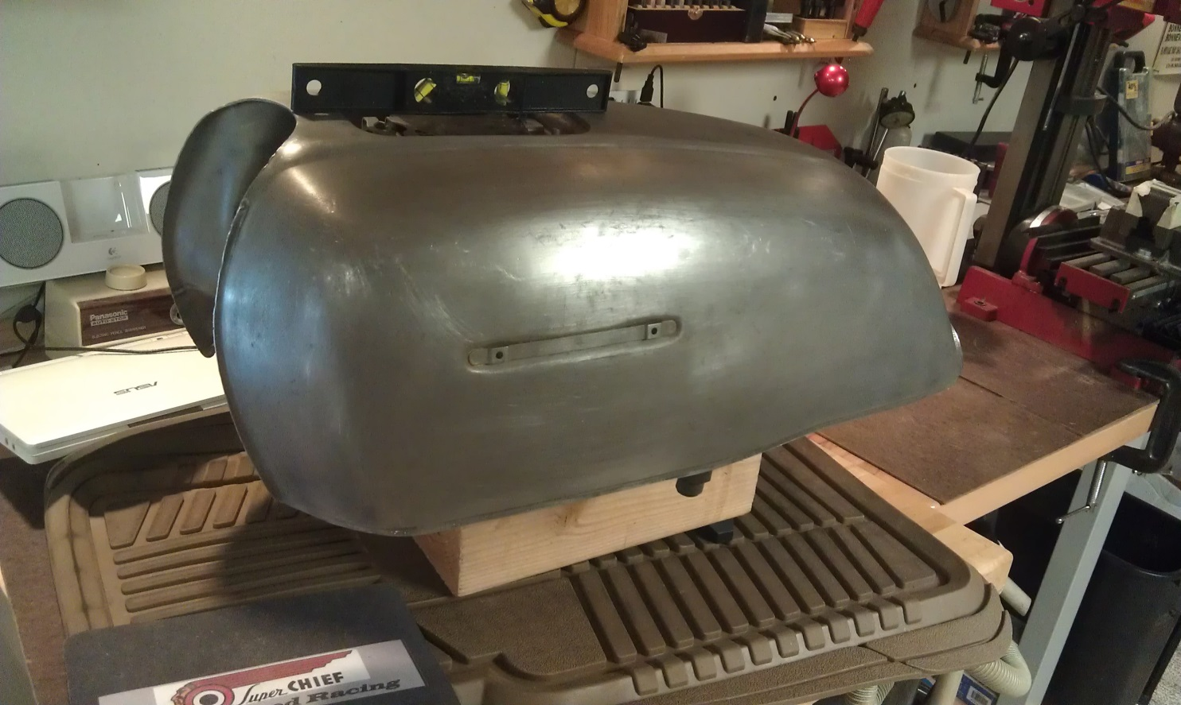
Top of tank must be level
Fuel cap area of tank must be level ( shim tank as necessary, must support 5 gallons of water! )
Use an old car floor mat under tank to catch stray liquid !

Slide 11
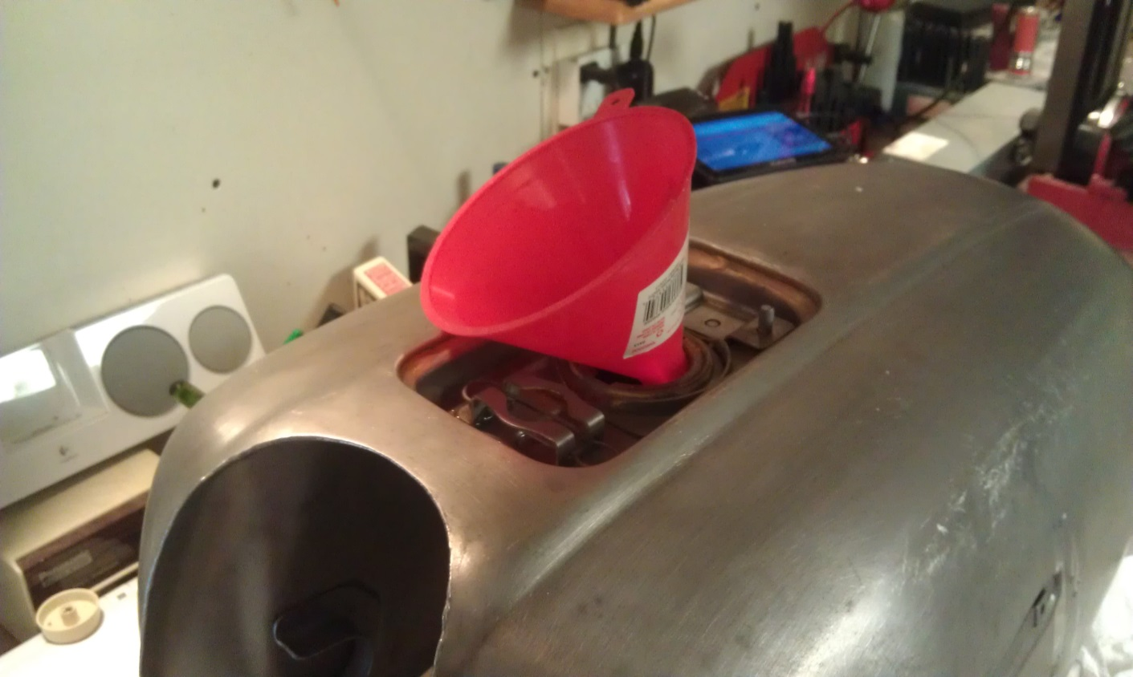
Carefully add etchant to Tank
Carefully pour in 1st gallon of etchant solution (use a funnel, we are dealing with a mild acid here ! Check for leaks in petcock plug area, repair as necessary)

Slide 12
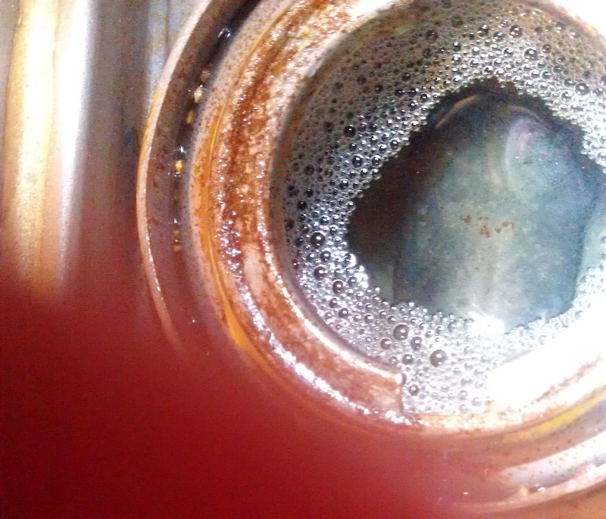
Fill’er up, but be careful !
Continue filling tank with etchant until it is full (keep checking for leaks & any shifting of tank as it is filled !)

Slide 13
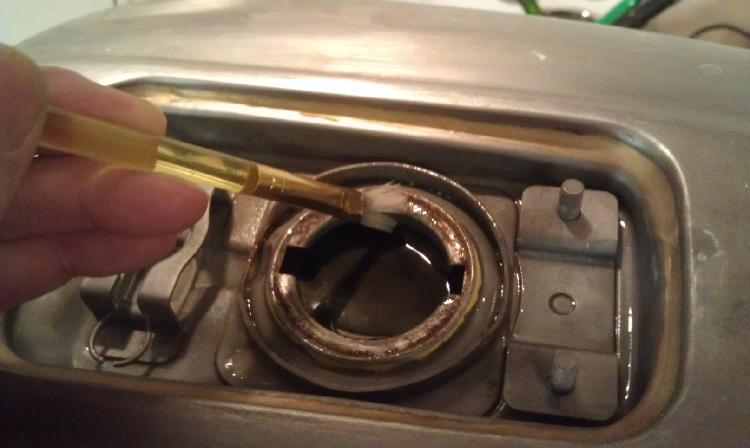
Gas cap area needs attention
Using a small paint brush, add some etchant to the gas cap sealing surface

Slide 14
Now we wait . . . .
Leave tank sitting for about 8 hours for etchant to do it’s work (12 hours max)
Continue checking tank for any leaks
Use artist paint brush to reapply some etchant to fuel cap area every couple of hours

Slide 15
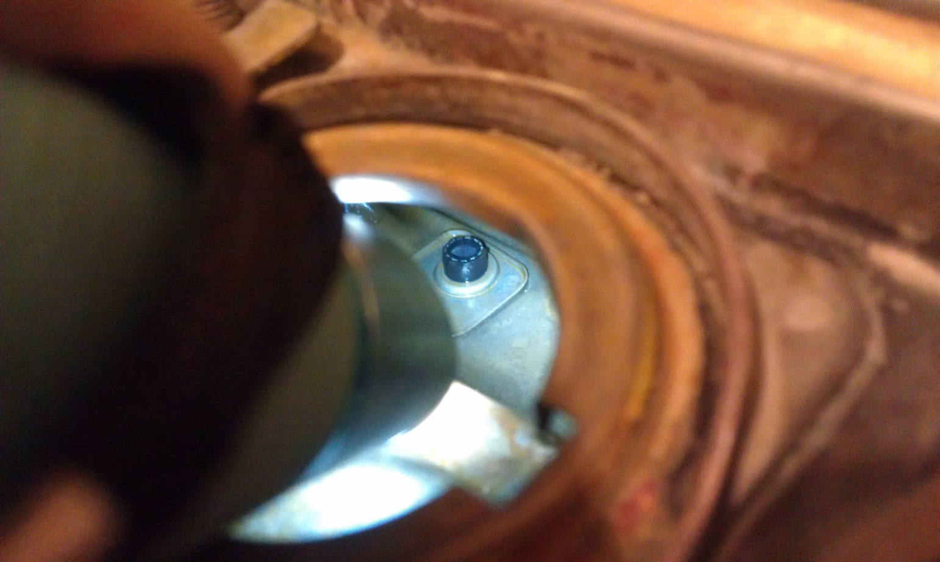
The results . . .
With any luck the rust will disappear !

Slide 16
Gas cap area looks nice too !

Slide 17
Now we remove the etchant and rinse thoroughly . . .
Use siphon hose through gas cap hole, drain etchant solution into a large plastic bucket (5 gallon or larger, do not remove petcock plug! )
Go outside and flip tank upside down to remove any remaining etchant , rinse with water to remove any loose scale or debris
(BE CAREFUL, this is a mild acid we are dealing with. Due to the recessed area for the gas cap, getting all the solution & water out can be a challenge, do your best!)

Slide 18
Let it dry, Let it dry, Let it dry . . .
Very Important:
Inside of tank must be completely dry for the sealant to adhere properly
This may take some time, but all traces of solution in the tank must be gone

Slide 19
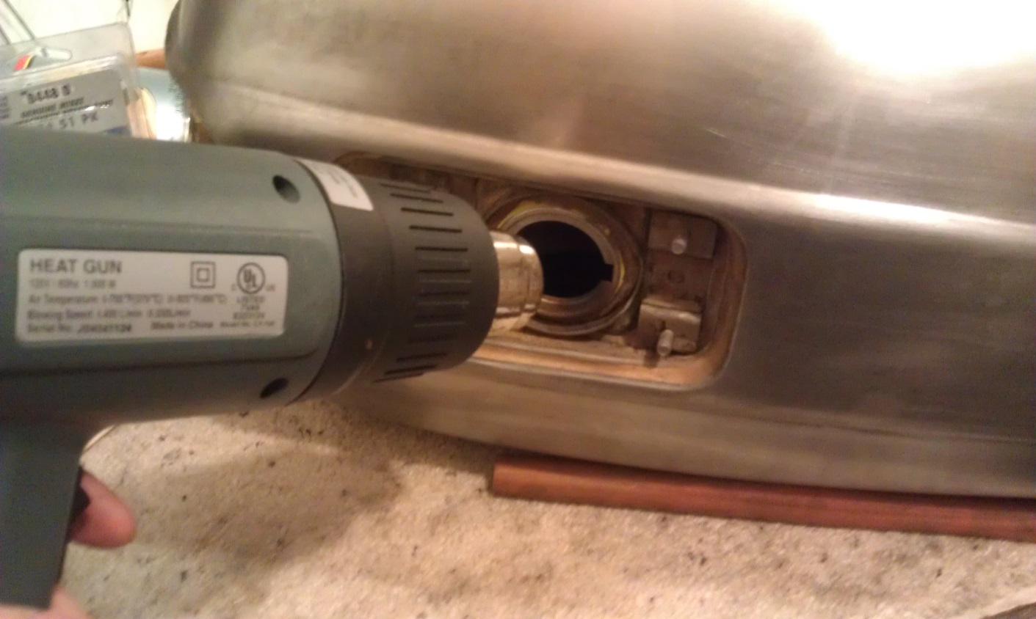
How dry I am . . .
Suggest a small space heater directed at tank.
(Also look through gas cap hole, use hair dryer or heatgun to dry up last traces of solution.)

Slide 20
Now we seal it up !
For a final check, roll the tank slowly a few times, then check in the gas cap hole for any traces of solution.
Inspect inside of tank with small flashlight, if everything looks completely dry proceed with sealing, if not go back to drying cycle . . . . . . . (to allow for an adequate drying time you may have to postpone the sealing process until the following day)

Slide 21
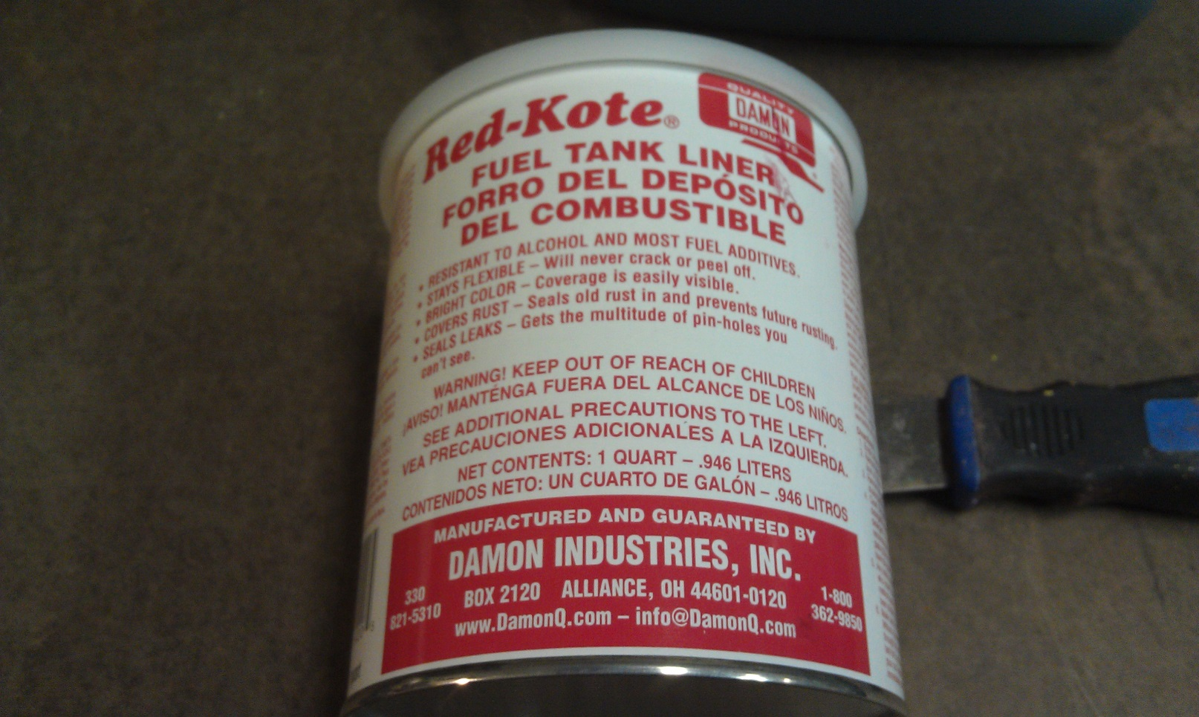
Let’s do it !
Read the directions on the sealant can . . .

Slide 22
The sealing begins . . .
One quart of sealer seals up to a 6 gallon tank. In a well ventilated area, start by poring in ½ of the can using a funnel

Slide 23
The fun begins . . .
Slowly tip gas tank side to side & front to back getting sealer to completely cover sides, bottom, front & back of tank.
Inspect progress thru filler hole w/small flashlight, continue until everything is coated
On badly rusted tank repeat above steps to get multiple coats of sealer on sides, bottom & front & back

Slide 24
Now the top of the tank
Now everything but inside top of tank should be adequately coated.
Inspect remaining amount of sealer in tank, if necessary add a little more to coat top of tank
Cover filler hole of tank with duct tape, insure hole is completely sealed

Slide 25
Coating the top inside of the tank
Turn tank upside down, rock slowly back & forth, side to side.
Do this multiple times to insure adequate coating for top inside of tank.
Flip tank back to normal upright position and remove duct tape on filler hole

Slide 26
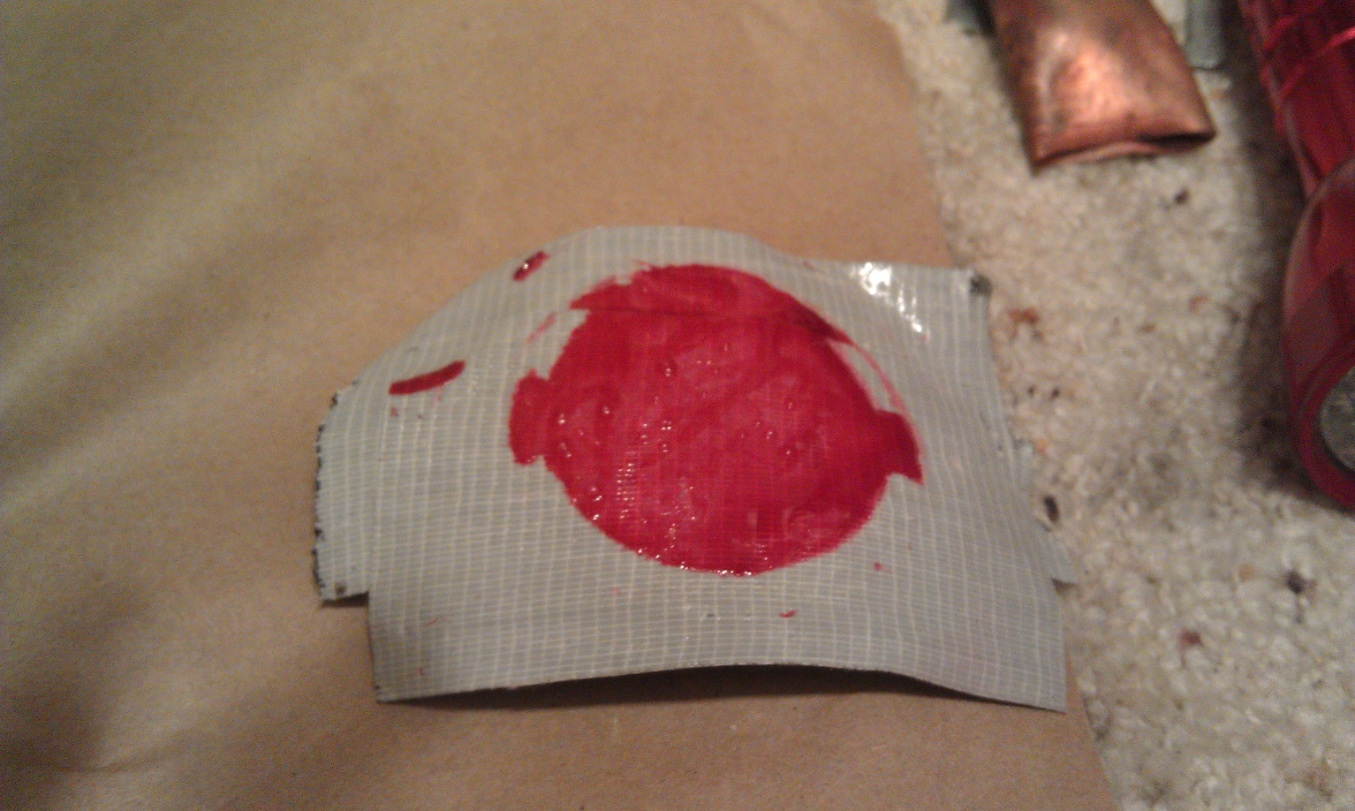
Almost done !
Done correctly results in duct tape below, if not add small amount of sealer & repeat .

Slide 27
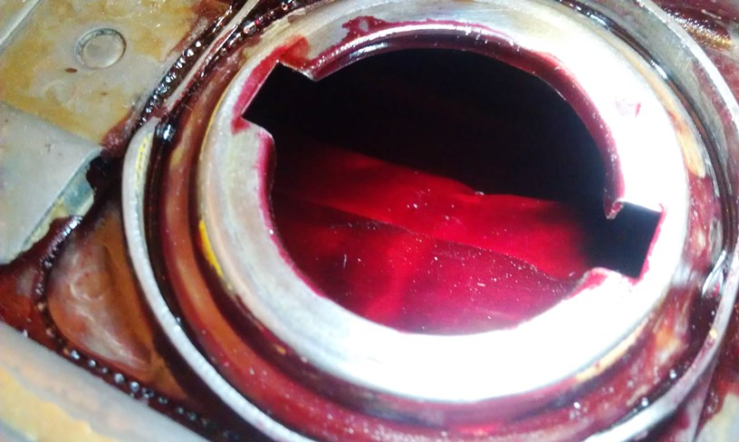
At last we’re done !
At last we’re done !
Sealer needs to cure for at least two days
Now we have a gas tank that should out last the motorcycle ,
Good job !

